Slide 1
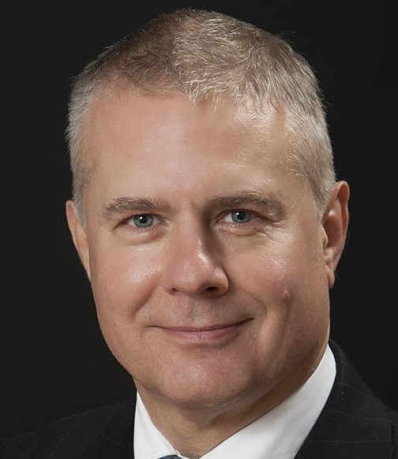
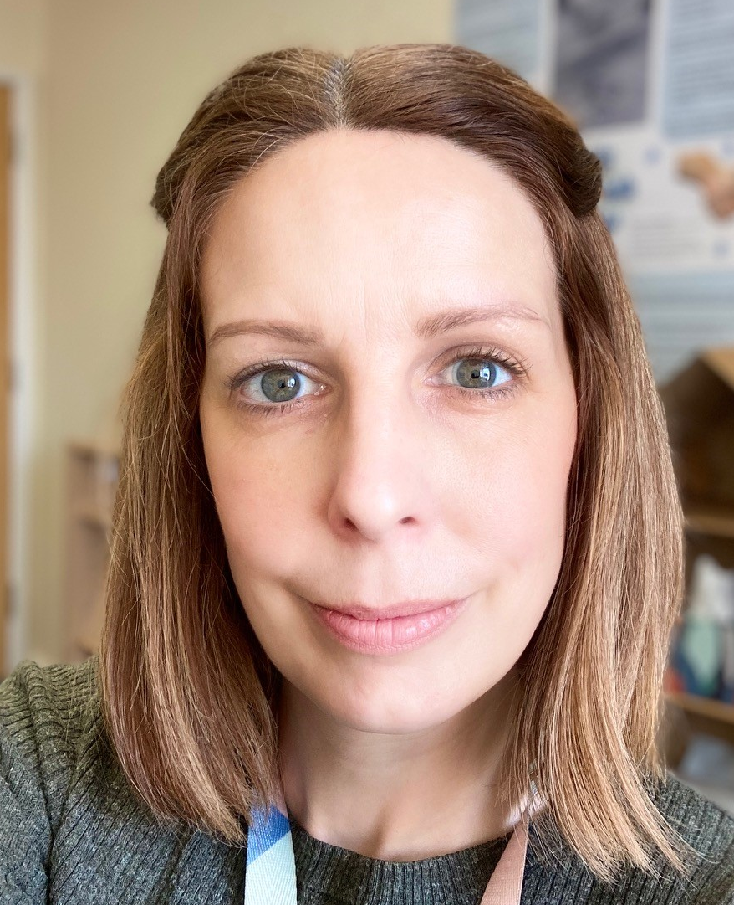
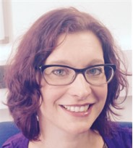
Background
Research Team
Exeter based:
5 Million UK people affected by severe obesity
Over 1000 new referrals per year in Plymouth alone!
Long waiting lists, even before Covid
Pressures on staffing
Annual cost of obesity estimated £2.47-5.1 billion
Prof. Mark Tarrant
Prof. Jonathan Pinkney

Slide 2
Research Programme
How are treatment outcomes for people with severe obesity ImPROved by GROUP-based behavioural intervention?
NIHR funded programme - 5 year £2.5 million
Started 1st May 2021
Year 1
Development
Permissions
Begin feasibility
Year 4
Completing intervention
Collect follow up data
Year 5
Complete trial Consolidate data
Final analysis & write up
Year 2
Run Feasibility
Assess & review for Main trial
Year 3
Run Definitive trial
Ongoing recruiting

Slide 3
Model of behaviour change
Notes:
our study will be framed by the social identity approach to health²³ ²⁴, specifically the Social Identity Model of behaviour change (SIM:BC)²⁵. The SIM:BC describes the intended patient processes/experiences and outcomes (top part of Figure 1), AND emphasises the critical role of the group facilitators in co-producing this (bottom part of the figure). By understanding the development of a positive group dynamic in which patients form a shared social identity, we aim to provide a foundation for introducing established behaviour change techniques targeting specific physical activity and dietary behaviours.

Slide 4
Feasibility RCT
Embedded realist processes evaluation
Patients referred to specialist Tier 3 weight management service are screened by Tier 3 staff, study offered to eligible patients, consent & record baseline weight.
In-person observation of group delivery (n=10)
Audio recordings of group sessions (n=40)
Upon recruitment of a cohort ≤ 30 participants, baseline questionnaire issued and patients randomised 1:1
Interviews with healthcare staff; Managers and facilitators (n=13)
USUAL CARE
Approx 15 participants per cohort
PROGROUP
Approx 15 participants per cohort
Weekly patient questionnaire feedback on group sessions (n= 250); Group processes patient questionnaire (sessions 3, 6 & 9) (n=71)
Conducted over 3 sites, 4 cohorts of up to 30 participants per cohort, total recruited 99 participants
Interviews with patients (n=18)
Follow-up : primary outcome (weight) and additional measures around health
3-month 6-month 12-month
Interviews with training team (n=2)
In-person site visits (n=3)
Weekly online feedback and support sessions with facilitators (total n=20)
Notes:
In the feasibility RCT, the realist evaluation focused on intervention mechanisms (i.e., participants’ experiences of the intervention) and contexts (i.e., culture/system/organisation), contributing to the optimisation of the PROGROUP intervention, and design and delivery of the planned definitive (RCT) which is underway.

Slide 5
Is PROGROUP working as expected?
Evidence that feeling safe, understood and supported is key to patient engagement
Evidence that treatment group social identity emerged during the intervention
Evidence that social identity may contribute to behaviour change
Evidence that poor attendance was associated with a lower feelings of group cohesion (attendance of others is crucial in how PG works)
Notes:
Mechanisms of action
PROGROUP (PG) trains facilitators to harness the power of groups through a range of activities to connect group members and build a sense of shared identity.

Slide 6
Is PROGROUP feasible and acceptable?
Staff and participants liked and believed in the intervention.
Online training was too long and focused too much on content over the development of delivery skills.
Facilitators delivered PG according to the manual, however it was apparent (from video analysis) that the education components reduced the time available to attend to group processes.
With referral rates of over 200/year, sufficient staffing levels, time to complete facilitator training and appropriate spaces to deliver group sessions are necessary for successful implementation.
Notes:
Key feasibility and acceptability findings.
We were able to run four cohorts across three different sites, with three completing the PROGROUP intervention in full.
Weight data was collected for 62% of participants, however not all weights were within the expected timeframe due to covid-19 interruptions in normal services.

Slide 7
Changes to Intervention
Reduced content to enable flexible delivery
Behaviour change content retained
Focus on delivering according to group’s needs
Introduction of group leaders
Increase behaviour change around Physical Activity
At home materials
Intervention manualisation and refinement
Identification and prioritisation of behavioural targets
Development of PROGROUP
Determine mechanisms of action and intervention content
Notes:
Started off identifying behavioural targets in existing services, developed theory and content around these and then manualised
Changes for main trial are mainly focussed on operationalising the mechanisms of action and how this is manualised
Reduced content so that facilitators could deliver according to the group and SIM:BC and intervention more tailored to needs of patients
Introduced group leaders to help with this and help group develop sense of ownership
Changed doing PA to focus on BCTs around PA (setting goals, identifying barriers and motivators)
Changes to Handbook to make these more accessible and streamlined (plus additional resources)

Slide 8
Changes to Facilitator Training
Delivery format
Three core topics delivered via short and interactive self-directed online modules (Future NHS)
Two 2-hr online workshops – one before starting modules and one when modules completed
Training repository – resources to accompany training
Content
Less educational content and more focus on group delivery skills
More knowledge and skill training around the PROGROUP approach to group management
Practical role play scenarios to ‘think on the spot’
Notes:
In response to feedback from our facilitators, we focused in refining our training programme to focus more on:
Delivery format
- Three core topics delivered via short and interactive self-directed online modules (Future NH - made for sharing materials and compliments group learning through functions such as forums for sharing with fellow peers)
Two 2-hr online workshops – one at the beginning to introduce the team and the programme and one at the end to practice skills e.g., role playing managing difficult members, bringing the group together in meaningful ways
Training repository – Resources to accompany training such as a facilitator handbook, session notes,. Go over any additional material in own time.
Content
Cut back on educational content such as 5-a-day and more focus on group delivery skills (e.g., delivering behavioural components to a group)
More Knowledge about PROGROUP approach to group management (e.g., group pulse, PROGROUP ethos)
Practical role play scenarios (to ‘think on the spot’ e.g., dealing with difficult members, ways to bring the group together etc)

