Slide 1
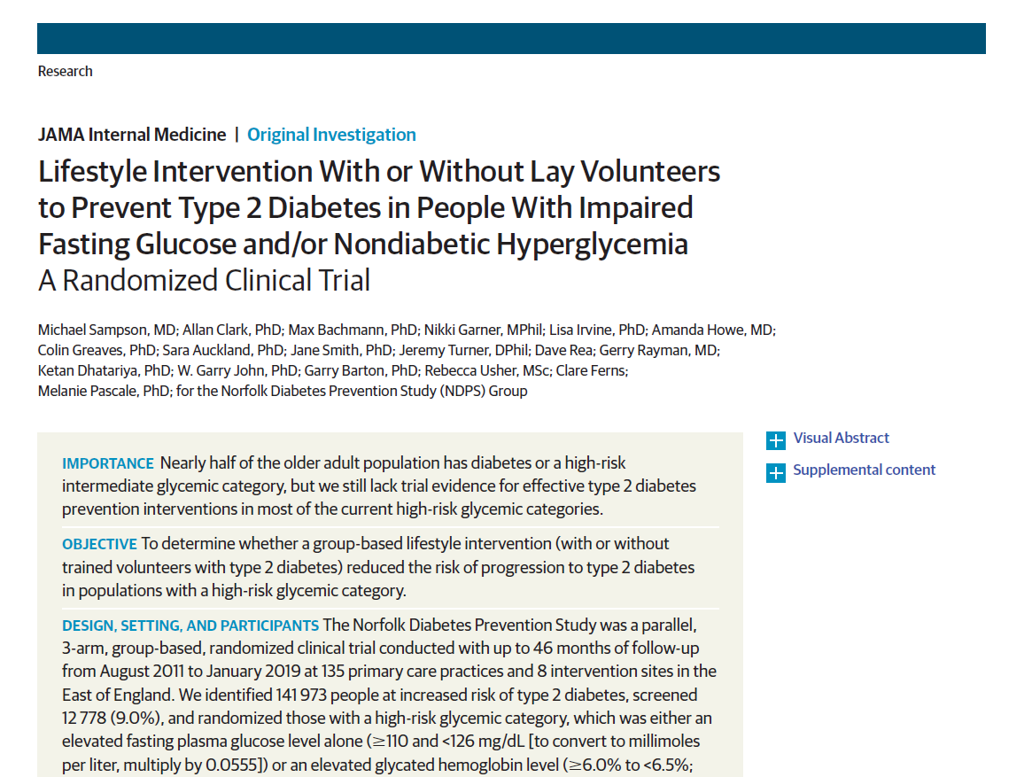
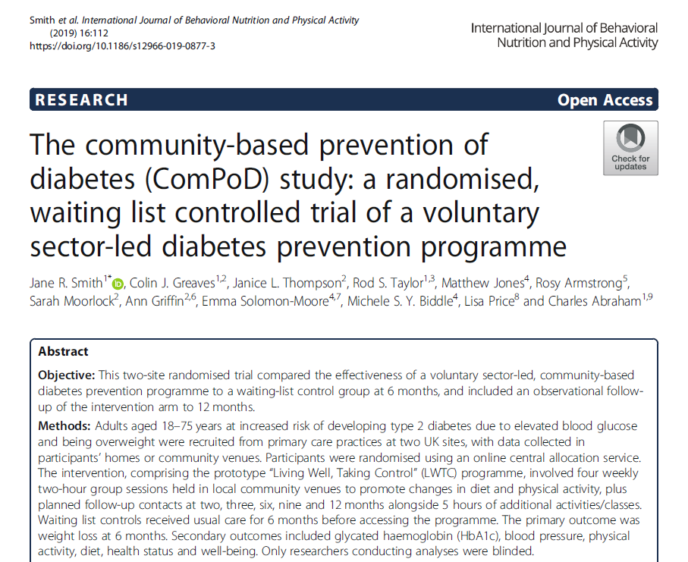
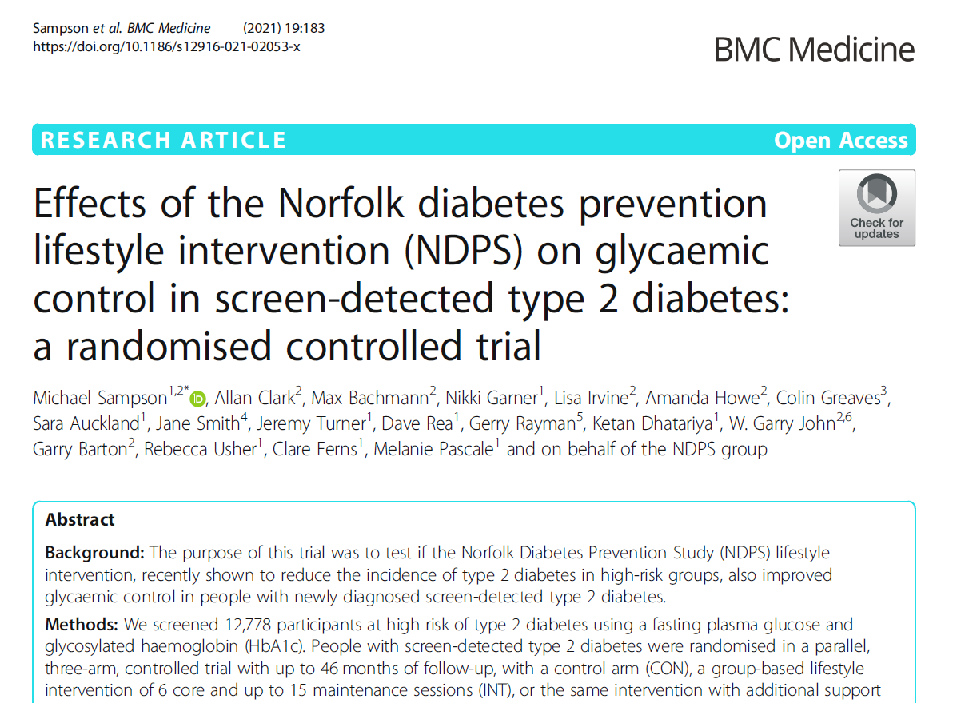
Group-based interventions
➔National NHS Diabetes Prevention Programme​
+ Work of previous Exeter colleagues (e.g. Greaves, Tarrant, Borek)

Slide 2
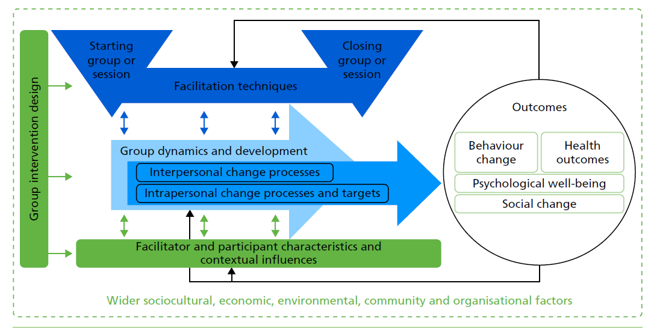
Mechanisms of action in groups
​Borek A, Abraham C, Smith JR, Greaves C, Tarrant M. A checklist to improve reporting of group-based behaviour change interventions. BMC Public Health 2015; 25;15(1):963. + Ola Borek’s PhD
EME funded: Mechanisms of Action in Group Interventions (MAGI) study
➔​ Framework, coding scheme, methods to identify and understand mechanisms of action in group-based, health behaviour change interventions (Borek A, Smith JR, Greaves CJ et al, 2019 EME report)

Slide 3
Recent & ongoing work on groups…
McDonagh S, Makukha N, Reburn C, Smith JR, Clark C. Group-delivered interventions for lowering blood pressure in hypertension: a systematic review and meta-analysis. Br J Gen Pract, under review.
Charlotte Reburn MByRes: Benefits, drawbacks and mechanisms of remote group-based interventions for prevention and management of chronic physical conditions (including Healthy Parent Carers, NHS DPP).
Grant for submission to EME primary care call with Luciana Torquati (PHSS) to explore mechanisms in whole-food, plant based remote group intervention (WholeLife) being delivered in local GP practices.
Discussions/potential interface re: work on new roles in primary care, social prescribing, psychological group therapies, rehab – ideas welcome!

