Slide 1
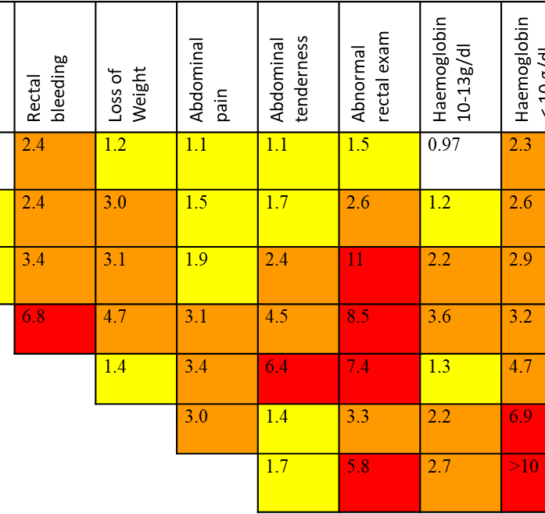
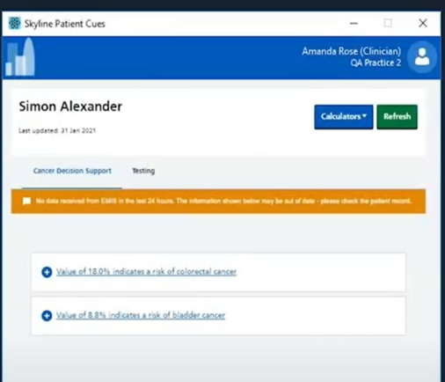
Adding colour to the ERICA trial through process evaluation
Notes:
Willie Hamilton, and his team have created a whole bunch risk assessment tools – which can be used predict cancer risk based on symptom or combination of symptoms.
These have been modified so that they can fit into GP computer systems
When a patients’ medical record is opened and if they have a 2% or higher risk of cancer the GP will get an alert. They can then explore the possibility of cancer with the patient in the consultation.
The theory is that these tools may help us catch cancer sooner. The eRATs have been subjected to a RCT of 440 practices in the UK, half of whom have been given access to the software.

Slide 2
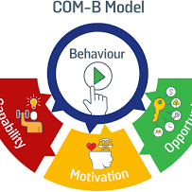
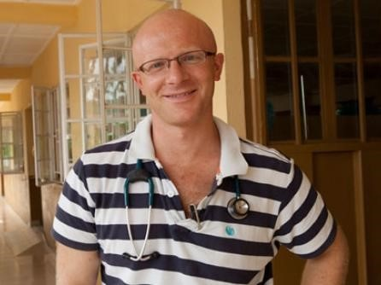
Software Installation
Software Use
Clinical Decision Making
Notes:
ERICA is a complex intervention. To help us understand and contextualise whatever the main trial results might be, we’re conducting a process evaluation.
Amongst other things we’ll be taking a close look at GPs behaviour and considering things lie how well they got on with installing the software – barriers and facilitators.
We’ll also be looking at their experience of using the tool.
Much of this approach is underpinned by the COM-B model of behaviour: So, when we look at these different aspects we’re considering/exploring GPs opportunities, capabilities and motivations for installation and use
(for example, was the training sufficient, were they personally invested in the trial or was it forced upon them by a senior colleague)?
We have a PhD that nicely dovetails with the process evaluation. Alex Burns, who is a GP, is supervised by Sarah Dean, myself and a couple of folk. His work is broadly looking at the impact of electronic risk tools on how GPs think about risk and communicate risk information.
All these strands of work will add colour to the ERICA trial.

