Slide 1
Digital enhancement of home-based cardiac rehabilitation for people living with heart failure – D:REACH-HF
Dr Samantha van Beurden
s.b.vanbeurden@exeter.ac.uk
Notes:
In this session I’ll give you an introduction to health psychology over the next 45 minutes or so

Slide 2
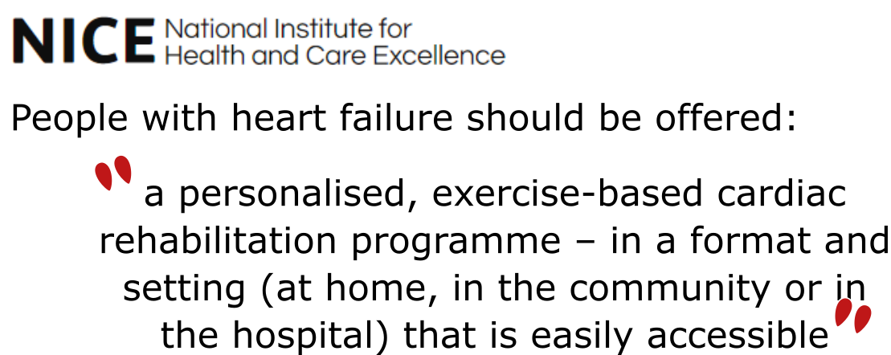

Slide 3
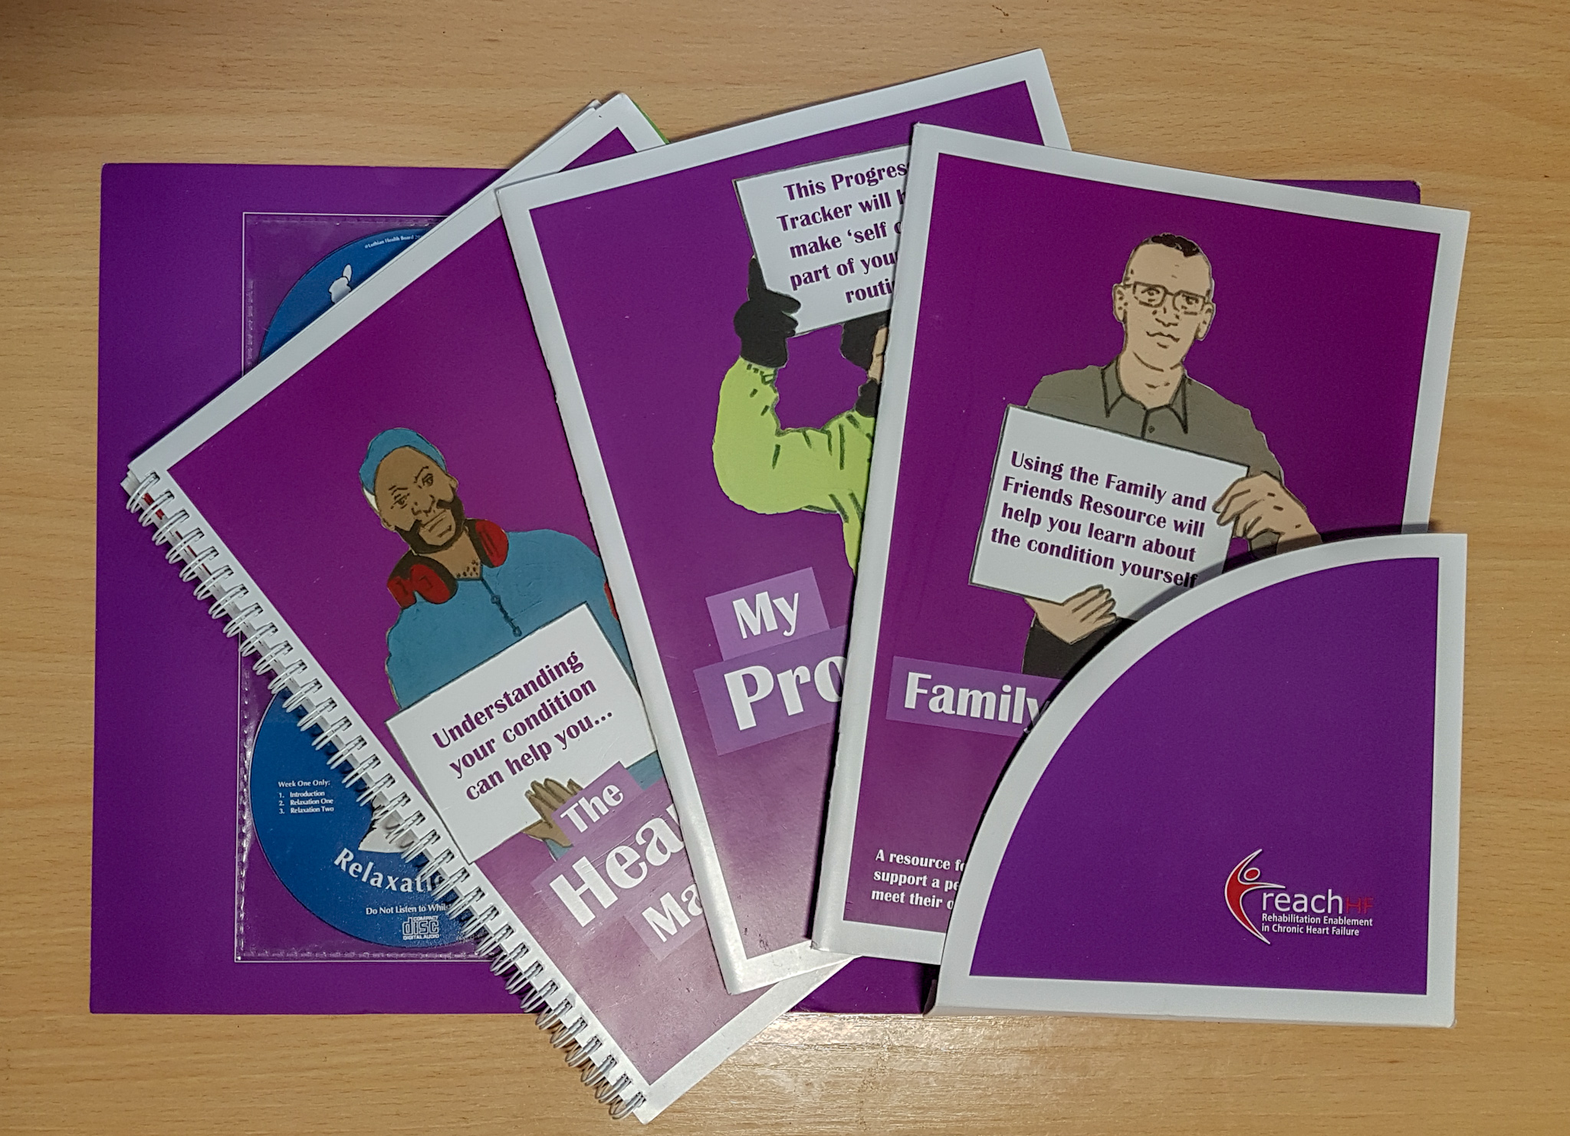
Optimising persuasiveness and engagement
Research
1
???
Patients
Caregivers
Health professionals
PPI
Intervention
2
12-weeks
Grant

Slide 4
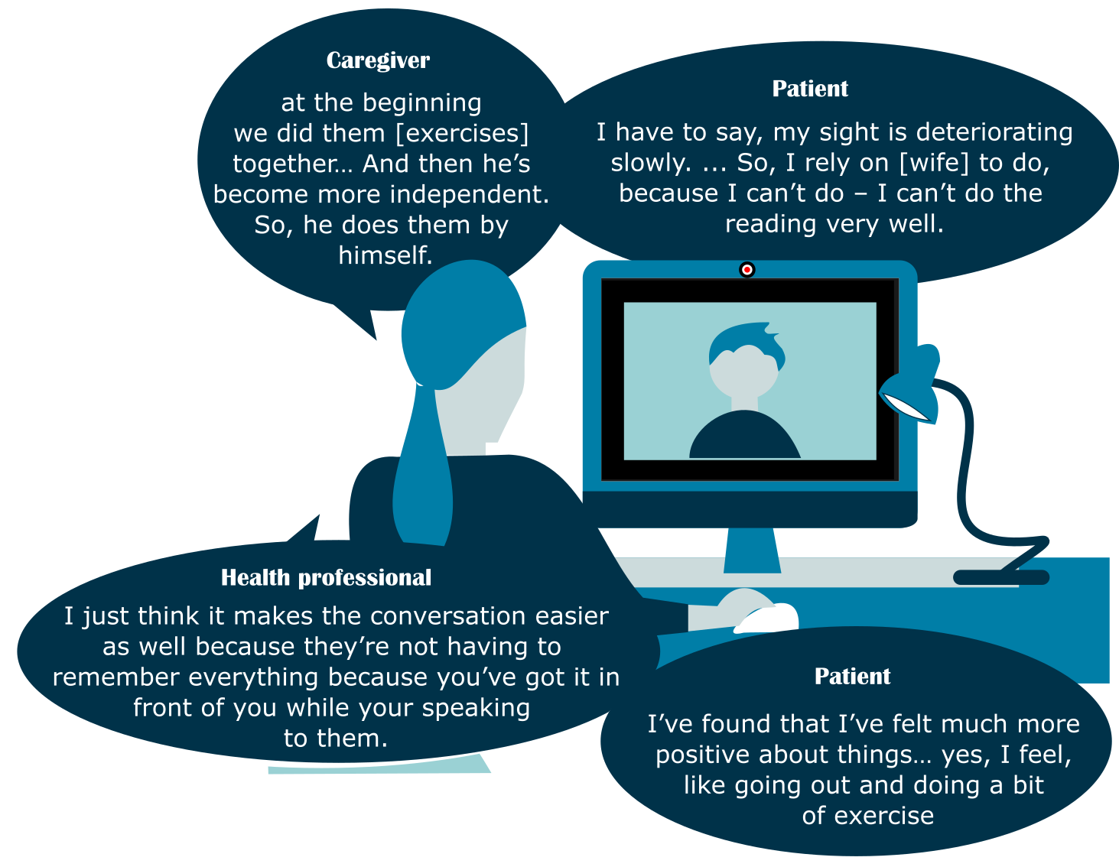
Interviews identified
Areas for change to optimise engagement further.
Improvements in physical and mental health, HF self-management and perceived independence.
Caregivers can facilitate engagement.
That active patient engagement from patient is crucial to be able to deliver intervention.
Enabled efficient personal-tailoring of consultations.

