Slide 1
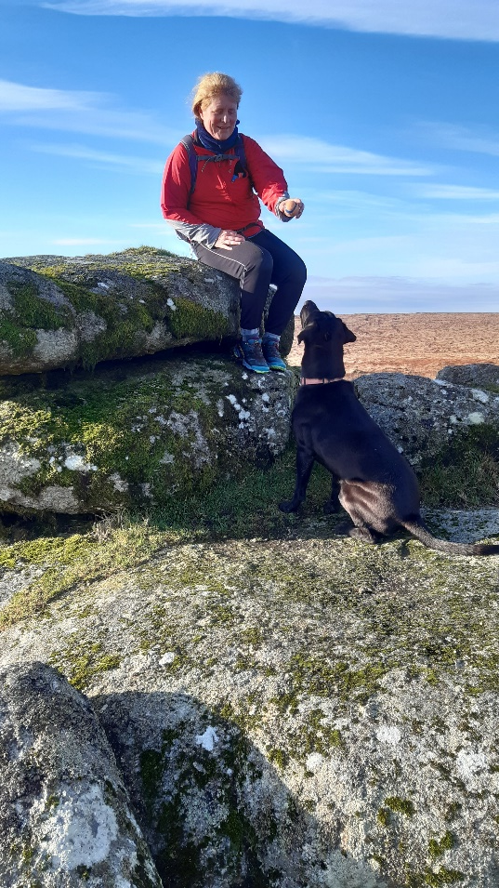
Mixed Method Behavioural Science:
intervention development and clinical trial process evaluations
Gary Abel et al, NIHR PGfAR £1.5m
Sarah Morgan-Trimmer, Mary Carter, Maria Valasaki, Liz Shephard, Sarah Dean
Sarah Dean
Professor of Psychology Applied to Rehabilitation & Health
Notes:
Hello, this is me on a Dartmoor tor – trying my hand at being a dog behaviourist with my lab Dart. At work I do teach and research about behaviour change, particularly for helping patients adhere to their exercises or clinicians to adhere to putting the research evidence into practice….plus from a methods point of view to design and then evaluate complex interventions, including fidelity issues, in clinical trials
On this slide is a follow-on study from what you have just hear Raff talk about – ERICA; in this SPOCC study we are investigating what if any are the reasons for delayed cancer diagnosis in people with multiple comorbidities. Sarah Morgan-Trimmer and I lead WP 2, with Sarah also leading WP5, this in ongoing work

Slide 2
New Zealand trial process evaluations
Ben Darlow et al $1.4m NZD
Co-creation and evaluation of a digital pain management programme – iSelf-help. A non-inferiority trial comparing on-line v in-person group-based programmes
Meredith Perry et al $1.37m NZD
Notes:
Now let’s move to the other side of the world, where former colleagues at the University of Otago continue to invite me to collaborate to help advise on process evaluations in their clinical trials funded by the Health Research Council of NZ.
The first is a pharmacy led study where patients are being signposted to receive interventions designed to help them self-manage their osteo-arthritic knees, the pharmacist identifies and screens patients and provides them with the standard leaflet (usual care) or signposts them to one or more modules of intervention – physio, nutrition, medication review etc. has just completed recruiting to target
The second trial took place over lockdown, it’s a group-based pain management programme testing 2 ways of delivery – in-person or on-line – called iSelf-help. it did not recruit fully to target but has sufficient sample size to determine non-inferiority – results are due in next few months.

Slide 3
Women’s Health Research
Christine MacArthur et al NIHR PGfAR £1m
Tori Salmon, Rohini Terry, Sarah Dean
Emma Pitchforth & Sarah Dean et al NIHR SPCR £47k
Rohini Terry, Christine Addington, Theresa Santosh
Notes:
My 3rd and final slide covers a big area of research that I am passionate about – helping women with their pelvic floor health, Rohini Terry and Tori Salmon being the researchers with me on these projects.
APPEAL has recently completed, and was about training midwives to support women to do their PFME during pregnancy, we now have 25 NHS Trusts adopting the training and 155 service leads have received their ‘train the trainer’ sessions and are training all their midwifery teams, and we hope to go on to get more funding to evaluate this national implementation
Pflexi is a much smaller development study follows on from APPEAL in that we are co-producing training suitable for GPs and nurses to deliver the same support for women attending primary care – throughout their life course, not just during pregnancy. This is completing very soon and we are planning the next funding application.
I’d be very pleased to answer any questions about any of these projects….

